Slide 1


Cybersecurity in Business
The Evolving Threat of Malware
A Presentation by Konrad Wiley

Slide 2

Malware is bad.
Source: Wikipedia.com

Slide 3

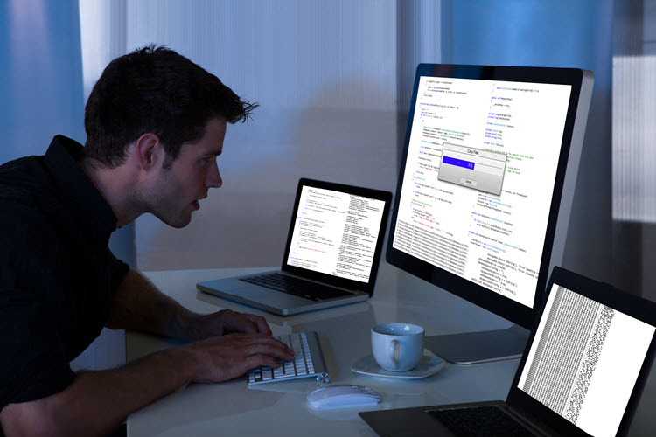
Research Topics:
How malware affects businesses
How businesses can be protected
Current malware trends
Current antimalware trends
Source: Malwarebytes Labs

Slide 4
How Malware Affects Businesses
Data Theft
Financial Theft
Property Damage
Loss of Public Trust
Government Fines/Lawsuits

Slide 5
How Businesses Can Be Protected
Industry Best Practices
Centrally-Managed Antivirus/Antimalware Software
Firewall Rules
Intrusion Prevention Systems (IPS)
Content Filtering/Inspection
Application Whitelisting

Slide 6
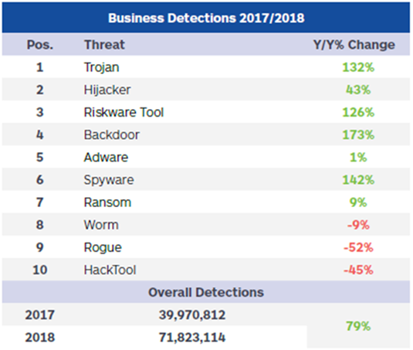
Current Malware Trends
Trojans Skyrocketing
Frequently cause additional vulnerabilities (such as…)
Backdoors Skyrocketing
Compromised systems allow hackers access
Spyware Skyrocketing
Compromised systems bleed information to hackers
Ransomware being used in precise, targeted attacks
Source: Malwarebytes 2019 State of Malware Report

Slide 7
Current Malware Trends
Trojans:
Spike in Trojans largely due to the release of “EternalBlue”
Published in 2017 by the Shadow Brokers
Originally discovered by the NSA, only disclosed after theft by hackers
Exploits vulnerability inherent in Microsoft Windows implementation of the Server Message Block (SMB)
Patches to Windows have addressed vulnerability, but many devices still unpatched
Fileless attack, extremely hard to detect

Slide 8
Current Malware Trends
Ransomware
Attacks began in earnest in 2017, but slowed in the general public
Tactics have evolved to coordinated and deliberate attacks on known targets
SamSam virus will not even operate without a secret command being given by the author
Result is weakpoints in network security being discovered and exploited by determined hackers
Ransom demands have become astronomical ($5.3M USD is current highest disclosed)

Slide 9
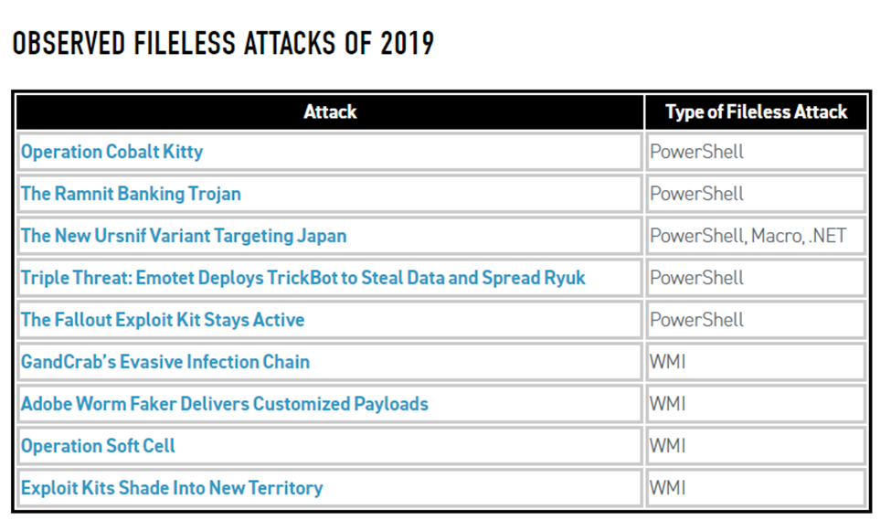
Current Malware Trends
Fileless Attacks:
Utilize trusted scripting interfaces on host
Load malicious code directly to memory
No downloaded file for AV to scan
Updates to malware can be published by author
Must be caught during execution, since they don’t exist any other time
Source: CyberReason.com

Slide 10
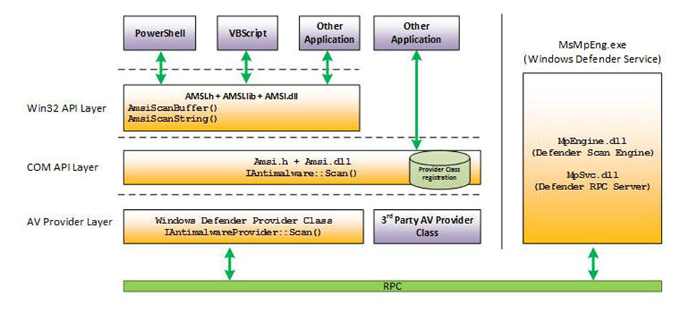
Current Anti-Malware Trends
Neural Networks
Able to recognize potentially malicious behavior rather than signatures
Allows detection of unknown threats (“Zero-day” threats)
Microsoft Anti-Malware Scan Interface (AMSI)
Direct integration of protection against fileless threats to OS
Gives antivirus systems execution-time access to scripted software
Source: TechRepublic.com

Slide 11
Current Anti-Malware Trends
Cybersecurity Insurance
Protecting a business from all cyber threats is impossible
Operational stability is critical to successful businesses
Insurance policies now exist to help businesses face cyber threats
Audits performed to ensure best practices are implemented
Threat vectors analyzed and factored into policy costs
Ransomware demands often covered

Slide 12
Current Anti-Malware Trends
Cybersecurity Insurance and Ransomware
Paying demands is often cheapest solution
Atlanta, GA refused $51K ransom and have spent > $8.5M recovering
Paying ransomware demands leads to increased attacks and demands
Many “Data Recovery” firms are fronts for ransom payments, as encryption is often unbreakable
Politically complex, and highly unethical

Slide 13
Malware is bad.
Source: Wikipedia.com

